Slide 1
DEPARTMENT OF CSE
Course name – COMPUTER NETWORKS
Course Code – 24CS2202
Topic:
SMTP
Session

Slide 2
AIM OF THE SESSION
To familiarize students with the basic concept of Application Layer Protocols
INSTRUCTIONAL OBJECTIVES
LEARNING OUTCOMES
This Session is designed to:
Introduction to Application Layer.
Basic components of E-mail-SMTP,POP3.
At the end of this session, you should be able to:
1. Write a short note on E-Mail and SMTP.
Describe POP3.
List out various protocols in application layer

Slide 3
AGENDA
Discussion about Application Layer Protocols
E- mail Server
Electronic Mail: SMTP [RFC 2821]
Various scenario in electronic mail
Purpose of Application Layer
Summary
Self-Assessment Questions
Terminal questions
References

Slide 4
Application Layer Protocols
The application layer is present at the top of the OSI model. It is the layer through which users interact. It provides services to the user.
E-mail
SMTP
POP3
IMAP
HTTP

Slide 5

Electronic mail
outgoing
message queue
user
agent
user mailbox
Three major components:
user agents
mail servers
simple mail transfer protocol: SMTP
User Agent
a.k.a. “mail reader”
composing, editing, reading mail messages
e.g., Outlook, Thunderbird, iPhone mail client
outgoing, incoming messages stored on server
mail
server
user
agent
SMTP
mail
server
user
agent
SMTP
SMTP
user
agent
mail
server
user
agent
user
agent

Slide 6
Electronic mail: mail servers
mail servers:
mailbox contains incoming messages for user
message queue of outgoing (to be sent) mail messages
SMTP protocol between mail servers to send email messages
client: sending mail server
“server”: receiving mail server

Slide 7
Electronic Mail: SMTP [RFC 2821]
uses TCP to reliably transfer email message from client to server, port 25
direct transfer: sending server to receiving server
three phases of transfer
handshaking (greeting)
transfer of messages
closure
command/response interaction (like HTTP, FTP)
commands: ASCII text
response: status code and phrase
messages must be in 7-bit ASCI

Slide 8
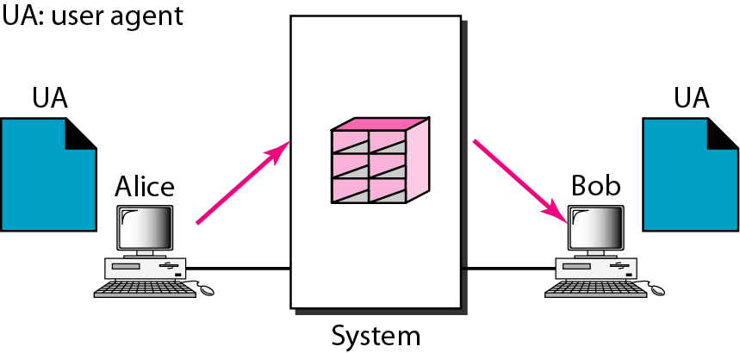
First scenario in electronic mail
When the sender and the receiver of an e-mail are on the same system, we need only two user agents.

Slide 9
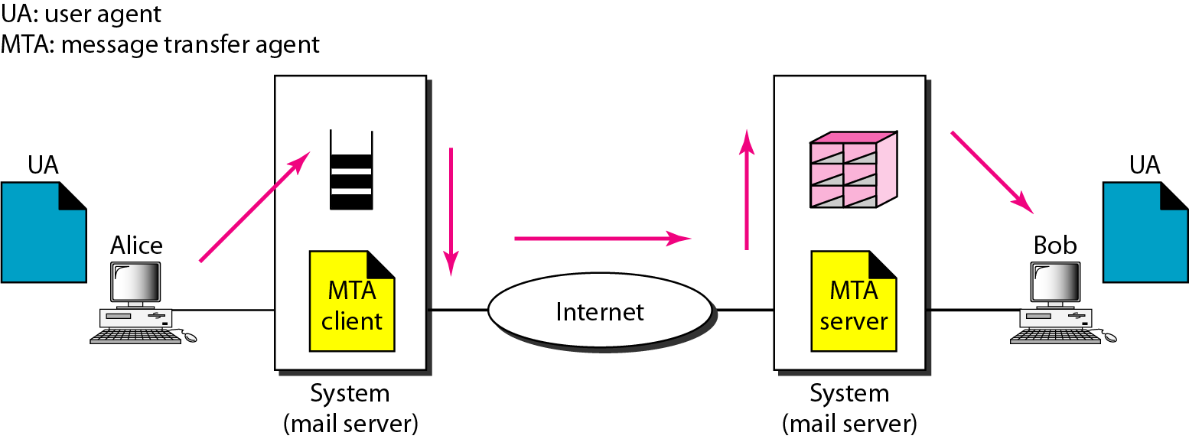
Second scenario in electronic mail
When the sender and the receiver of an e-mail are on different systems, we need two UAs and a pair of MTAs (client and server).

Slide 10
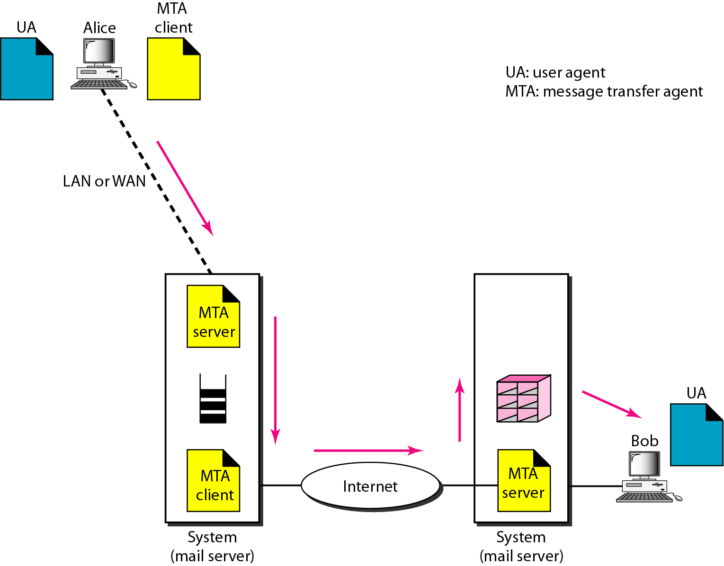
Third scenario in electronic mail
When the sender is connected to the mail server via a LAN or a WAN, we need two UAs and two pairs of MTAs (client and server).

Slide 11
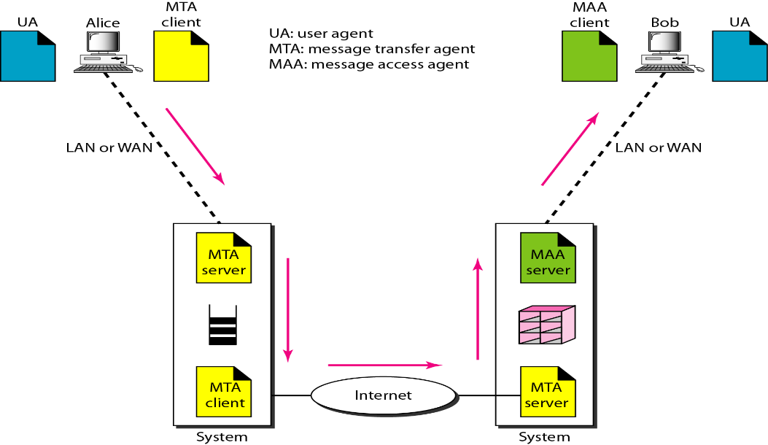
Fourth scenario in electronic mail
When both sender and receiver are connected to the mail server via a LAN or a WAN, we need two UAs, two pairs of MTAs and a pair of MAAs.
This is the most common situation today.

Slide 12
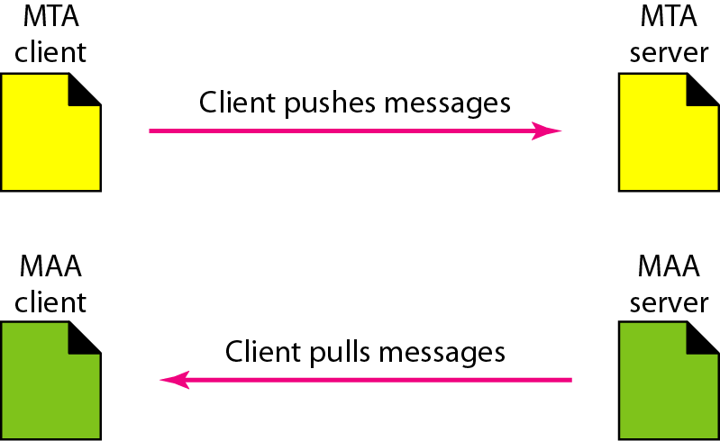
Push versus pull in electronic email

Slide 13
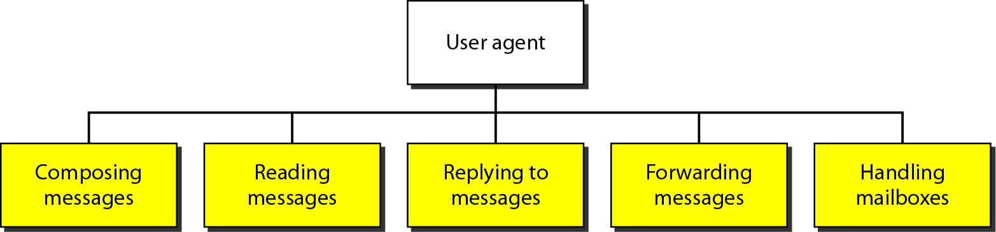
Services of user agent

Slide 14
Mail message format
SMTP: protocol for exchanging email msgs
RFC 822: standard for text message format:
header lines, e.g.,
To:
From:
Subject:
different from SMTP MAIL FROM, RCPT TO: commands!
Body: the “message”
ASCII characters only
Blank line
header
body

Slide 15


Mail access protocols
user
agent
mail access
protocol
user
agent
SMTP
SMTP
(e.g., POP,
IMAP)
sender’s mail
server
receiver’s mail
server
SMTP: delivery/storage to receiver’s server
mail access protocol: retrieval from server
POP: Post Office Protocol [RFC 1939]: authorization, download
IMAP: Internet Mail Access Protocol [RFC 1730]: more features, including manipulation of stored msgs on server
HTTP: gmail, Hotmail, Yahoo! Mail, etc.

Slide 16
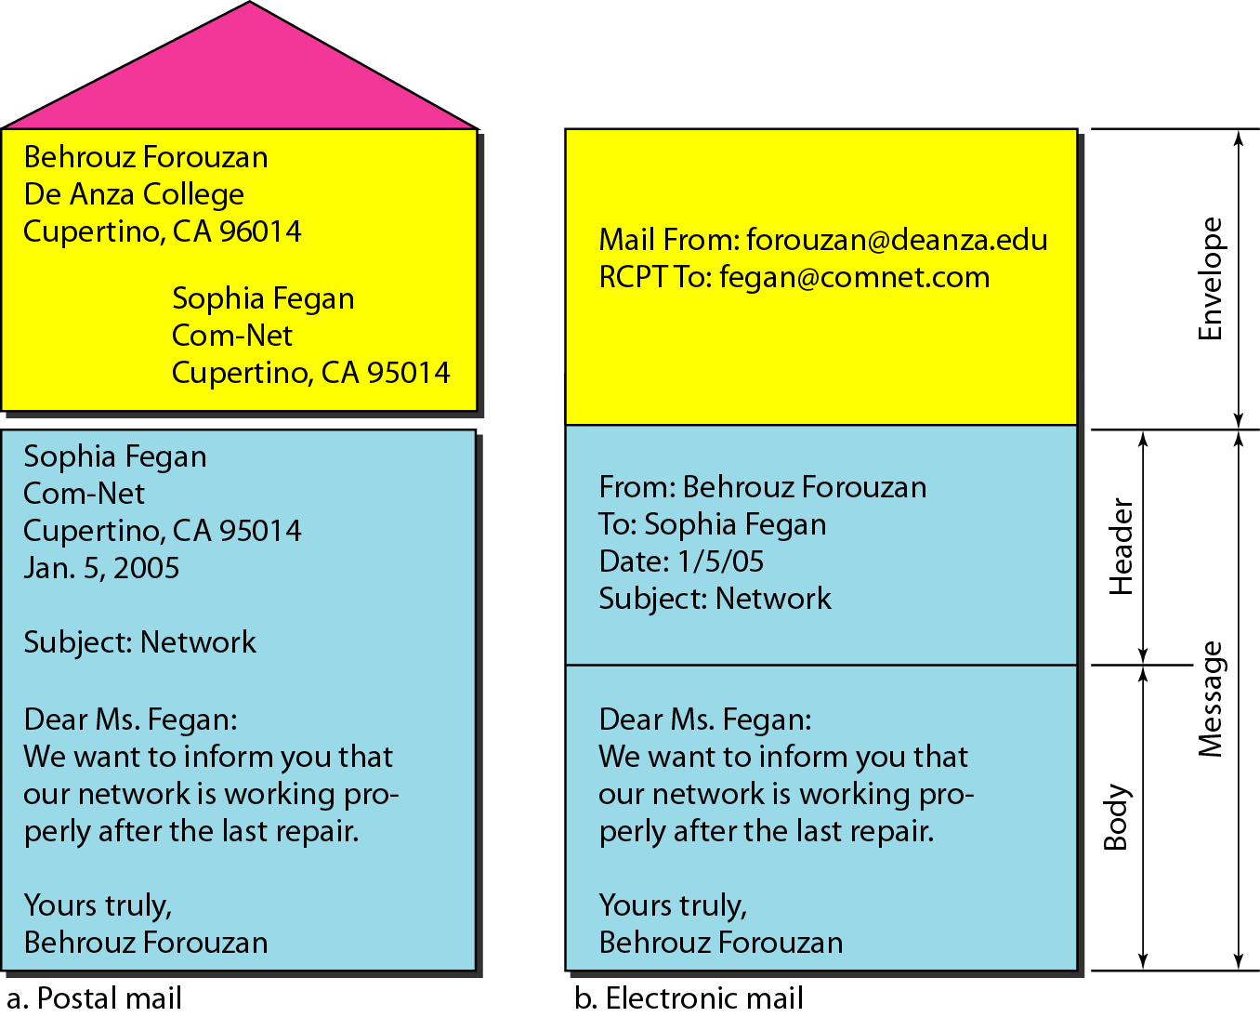
Format of an e-mail
Some examples of command-driven user agents are mail, pine, and elm.

Slide 17
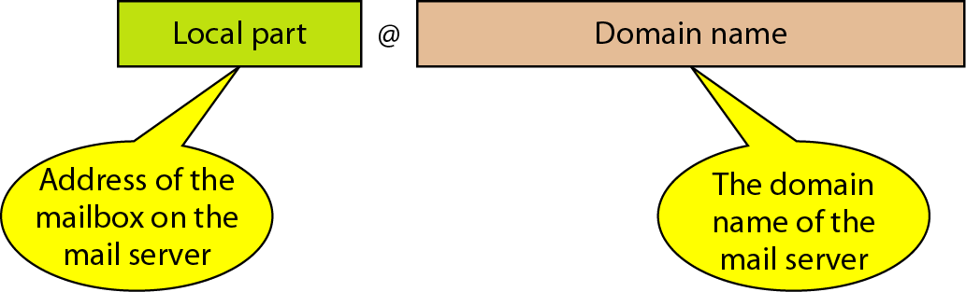
E-mail address

Slide 18
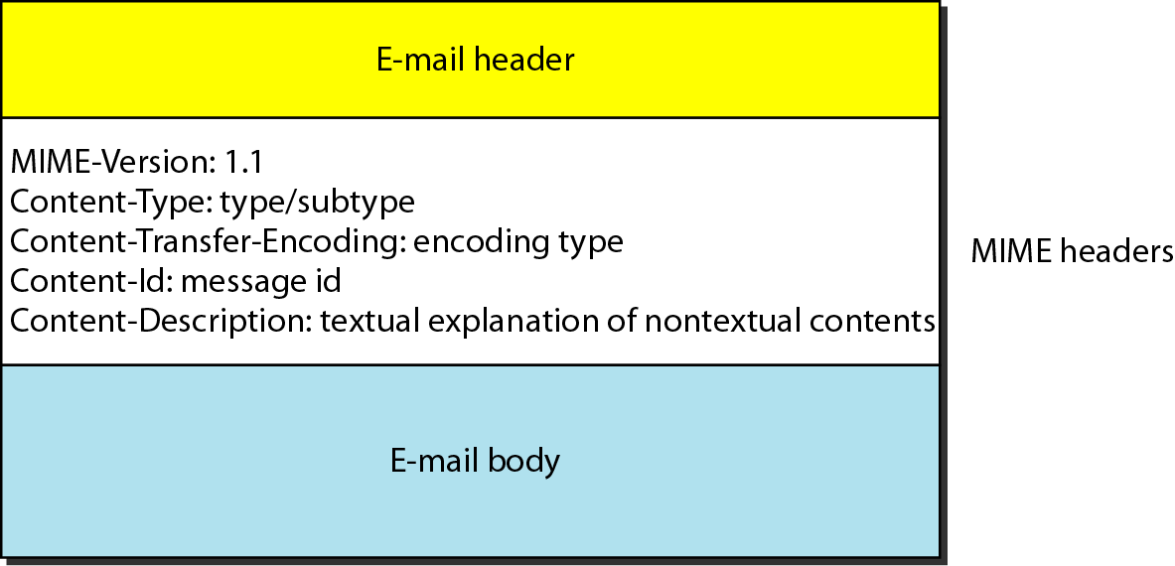
MIME header

Slide 19
Data types and subtypes in MIME

Slide 20
Content-transfer-encoding

Slide 21
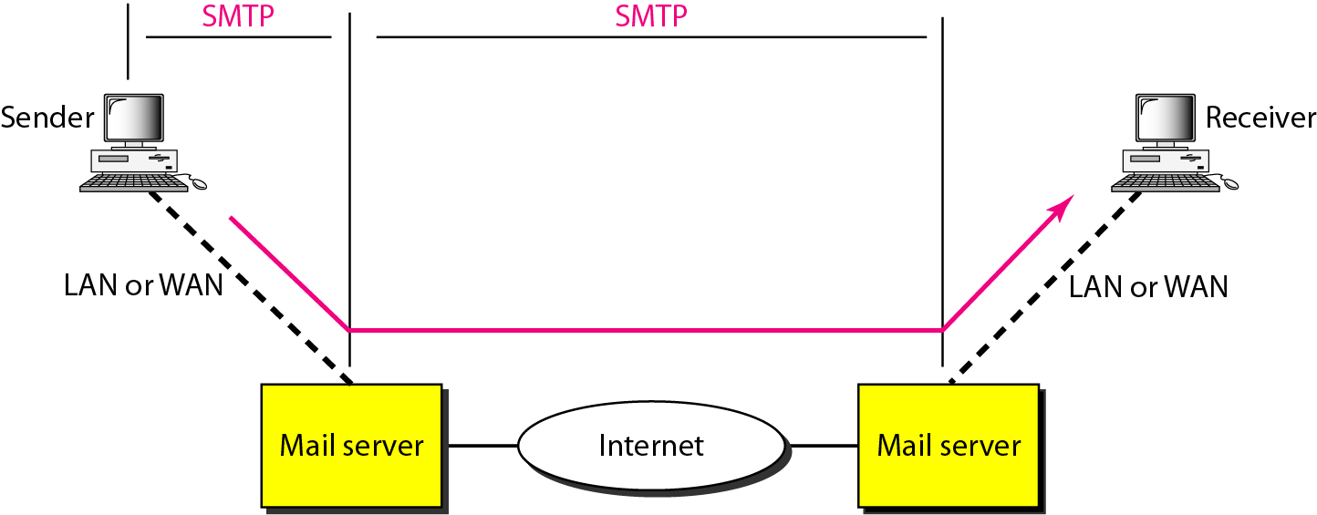
SMTP range

Slide 22
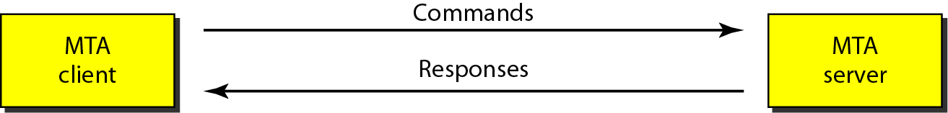
Commands and responses

Slide 23
POP3(Post Office Protocol Version3)
Current version is 3;POP3
User invokes POP3 client
Creates TCP connection to POP3 server
User authenticates by login & password
User client sends commands to retrieve messages
Computer with permanent mailbox must run two servers.
SMTP server accepts mail and stores it
POP3 server allows user to get messages

Slide 24
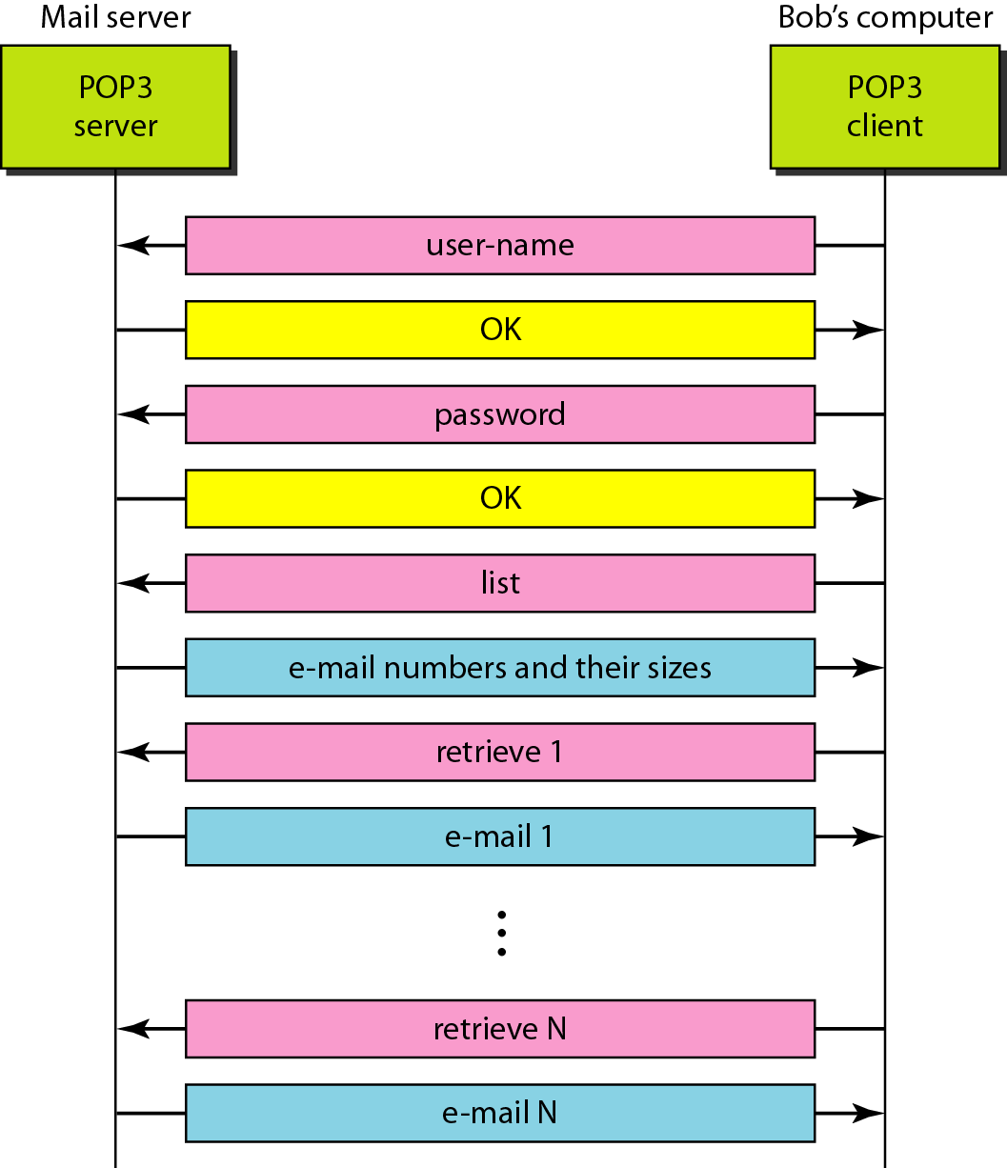
POP3(Post Office Protocol Version3)

Slide 25

SUMMARY
This unit provides a complete overview of application layer of TCP/IP.
Till now we have studied that there are various kinds of application layer related protocols. Some of them have been discussed in this unit, e.g., DNS, E-mail,SMTP,POP3,IMAP, HTTP and FTP.

Slide 26
SELF-ASSESSMENT QUESTIONS
1.Gmail.com, yahoo.com, yahoo.co.in, ymail.com, rediff.com, rediffmail.com, fastmail.fm, etc. are popular_________________
a. email servers c. social media sites
b. FTP servers d. None
2.SMTP stands for__________________
a. Simple Main Transfer Protocol b. Server Mail Transfer Protocol
b. Short mail transmission protocol d. Small mail transmission protocol
3.Post office protocol works on __________
a. application layer b. transport layer c, network layer d. data link layer

Slide 27
TERMINAL QUESTIONS
1.Write a note on email. 2. Explain about e-mail architecture and service.
3.What is (POP3) protocols.
4.Write the difference between IMAP and POP3. Why they are uses?

Slide 28
REFERENCES FOR FURTHER LEARNING OF THE SESSION
Reference Books:
Data and Computer Communications (5th Ed.)” – W. Stallings – PHI/ Pearson Education
Network for Computer Scientists & Engineers, Zheng & Akhtar, OUP
Data & Computer Communication, Black, PHI
Sites and Web links:
http://nptel.ac.in/courses/106105081/31
2. http://nptel.ac.in/courses/106105081/28
3. http://nptel.ac.in/courses/106105081/39

Slide 29
THANK YOU
Team – COMPUTER NETWORKS

